Slide 1
World Refugee Forecast
Nathaniel Arnold | Ashley Overman | Basheer Eljabaly | Rishi Khanna

Slide 2
Goals accomplished
Analyze refugee data (statistics and distribution) to correlate
Divergence of mean
Poission distribution
Select a sample of countries (because there are many in the data set we’ve been working with) in specific to analyze
Further analysis to determine a major factor (food deficit)

Slide 3
Divergence of mean
Best displayed with density plots and indicator lines for mean, median and standard deviation
In almost all countries chosen, the mean is greater than the median
Indicates right skewed data
Outliers to the right of the data

Slide 4
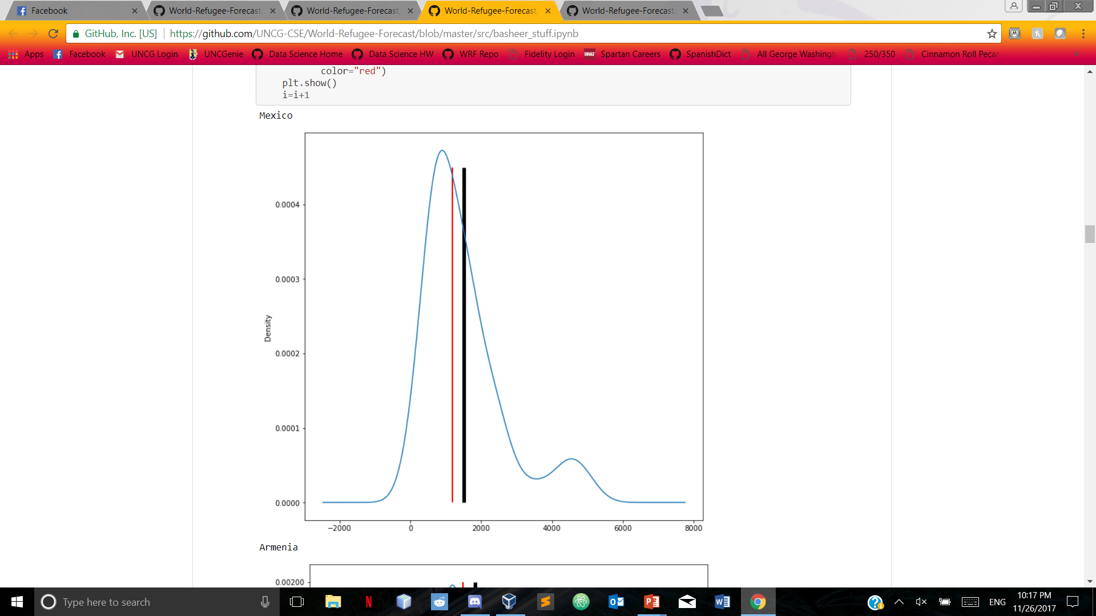
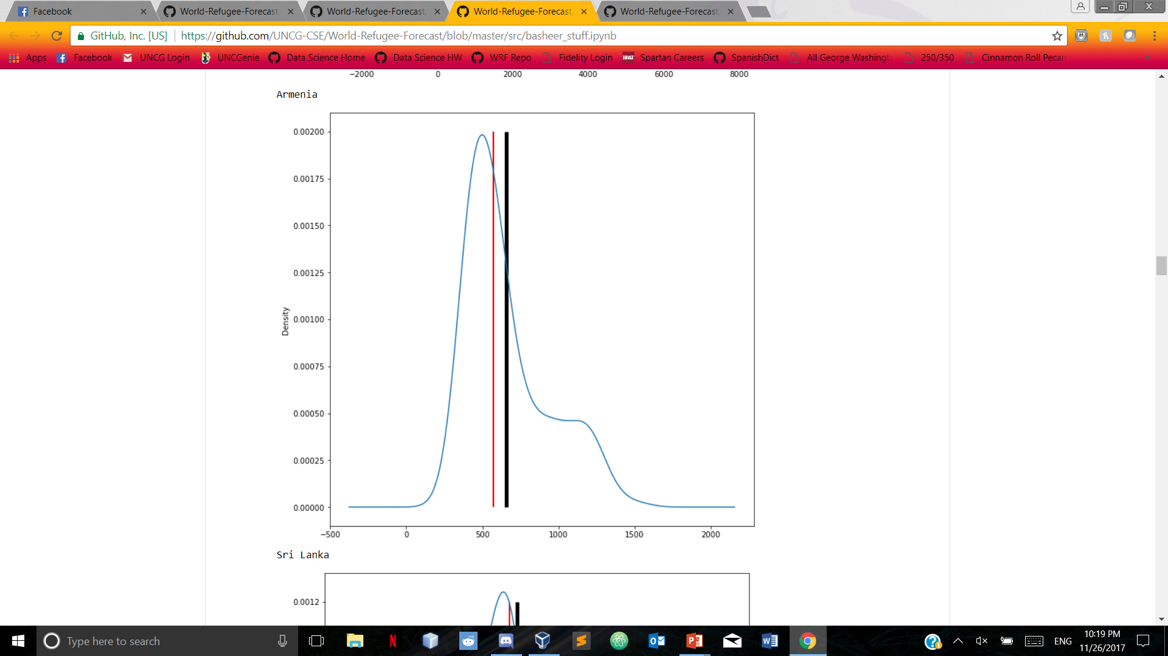
Divergence of Mean Mexico Armenia
Black line indicates mean, red line indicates median

Slide 5
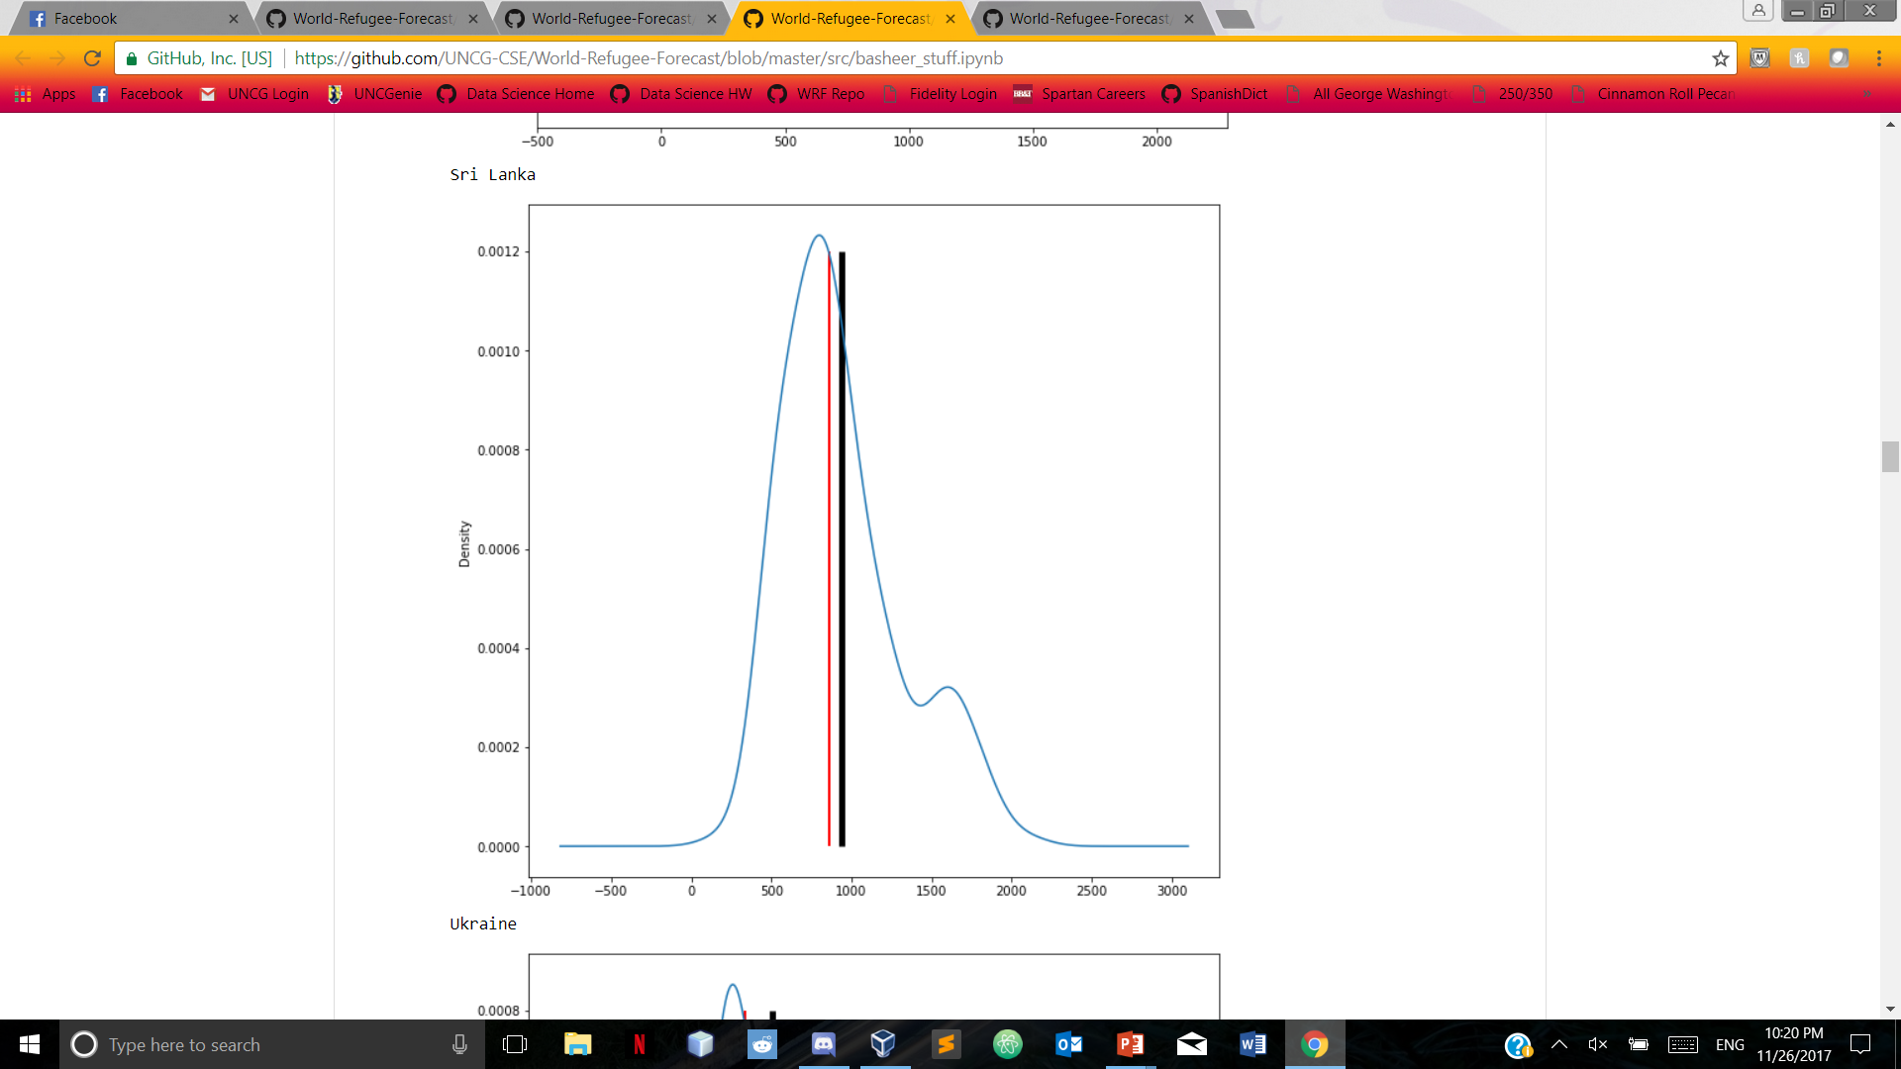
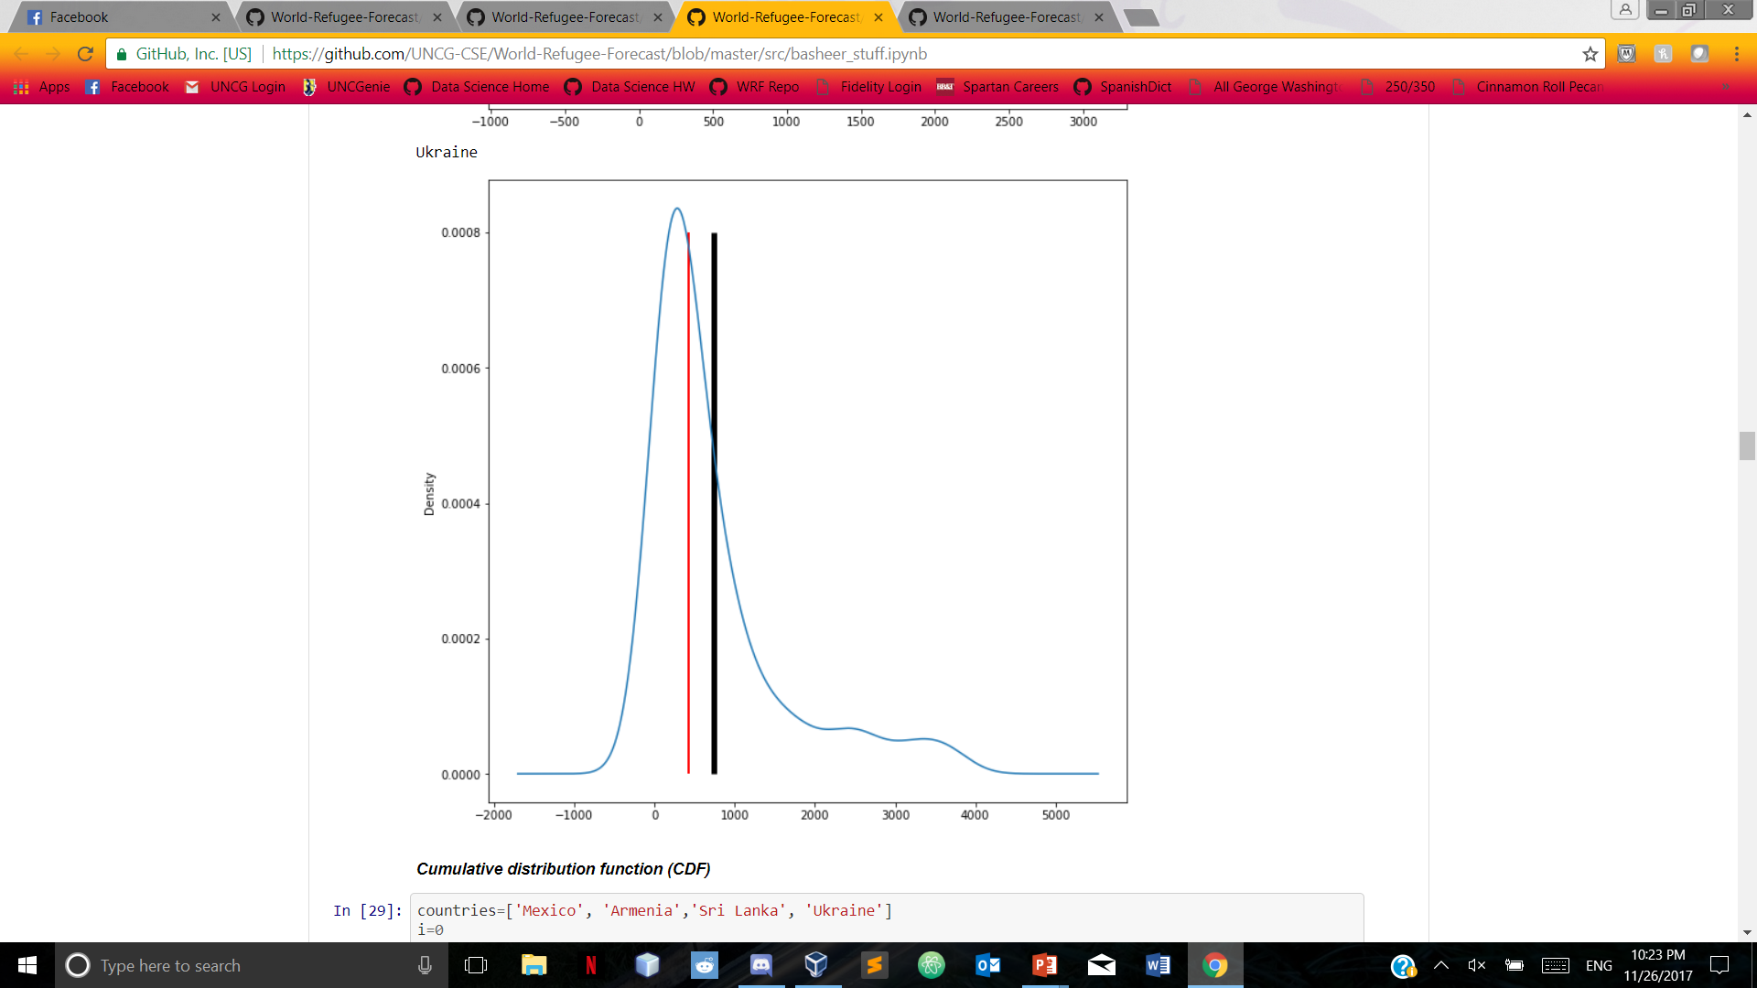
Divergence of Mean Sri lanka ukraine
Black line indicates mean, red line indicates median

Slide 6
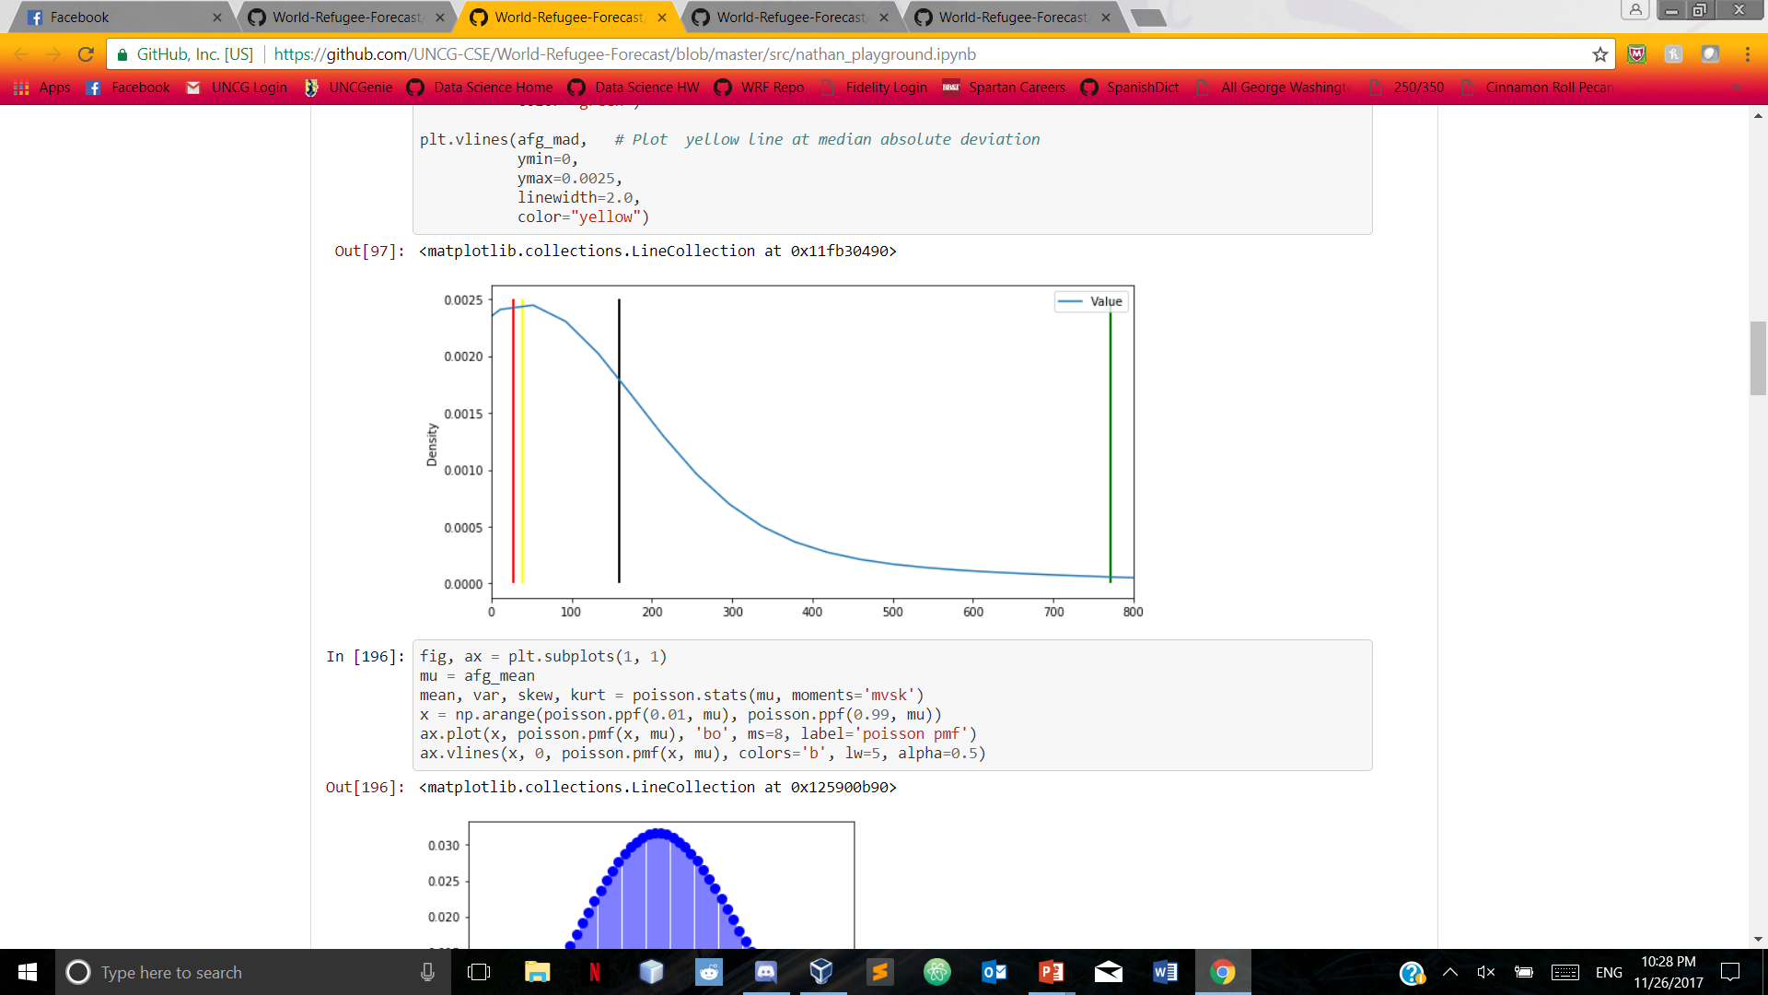
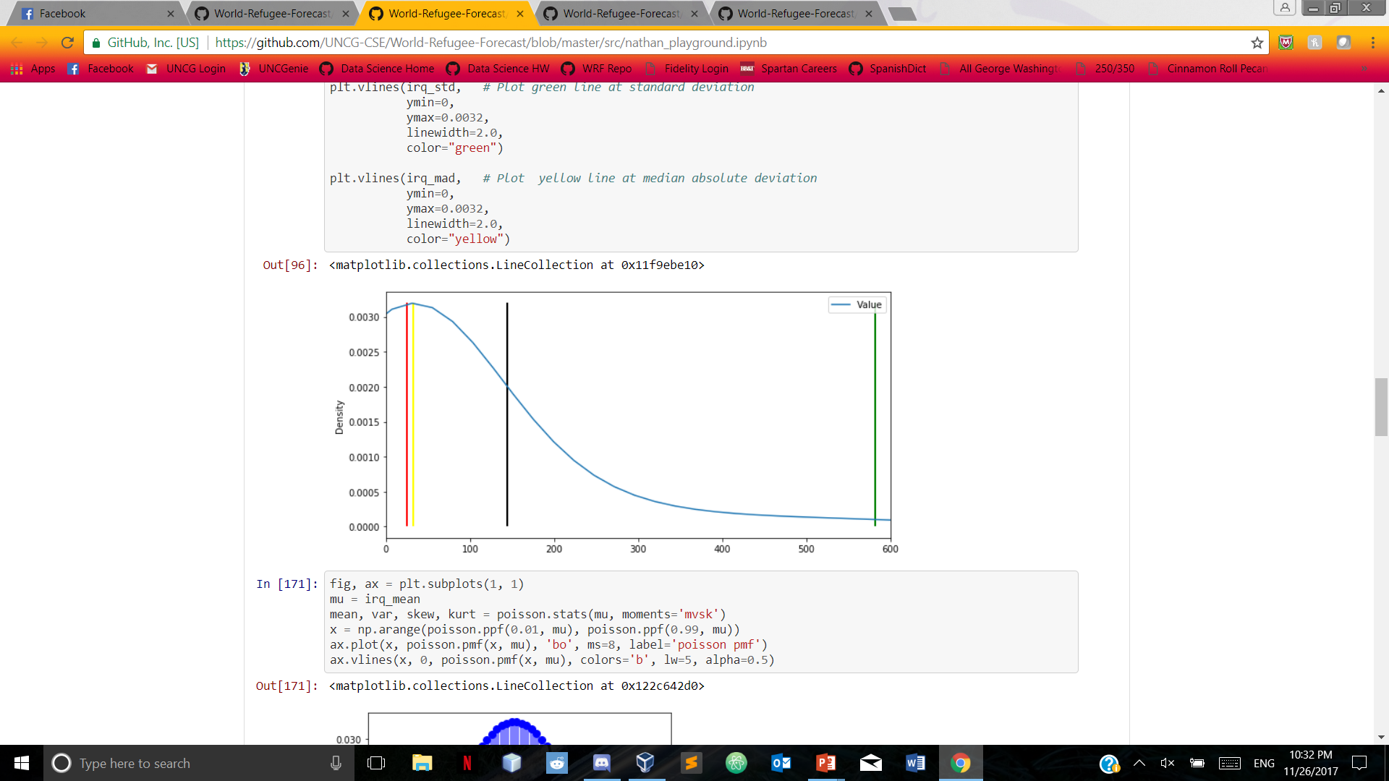
Divergence of mean Afghanistan iraq
Black line indicates mean, red line indicates median, green line indicates standard deviation, yellow line indicates median absolute deviation

Slide 7
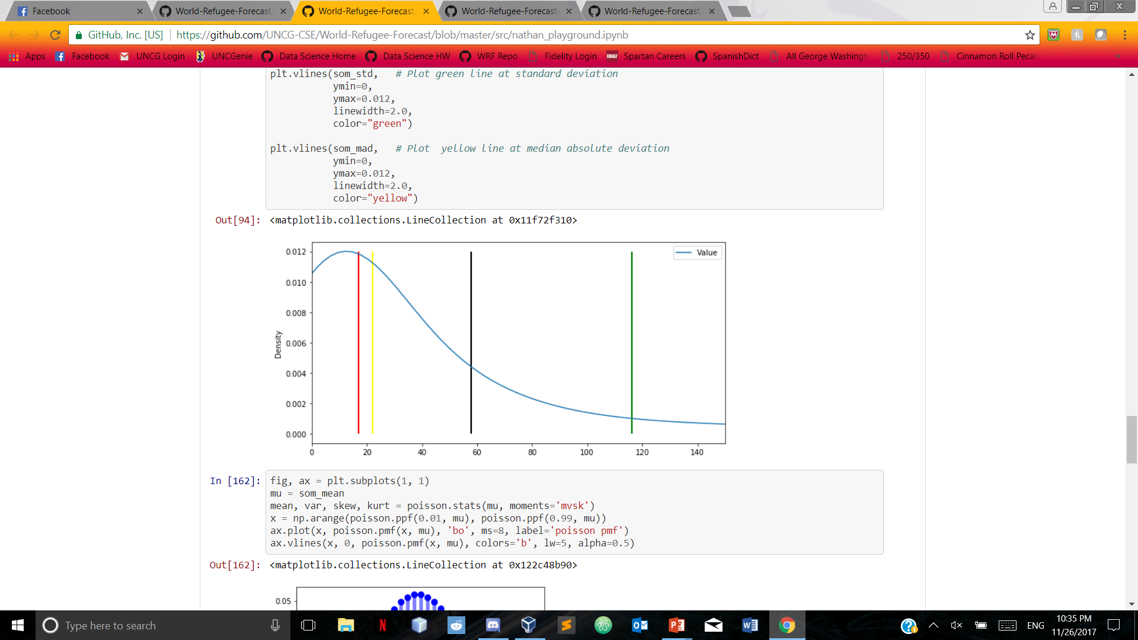
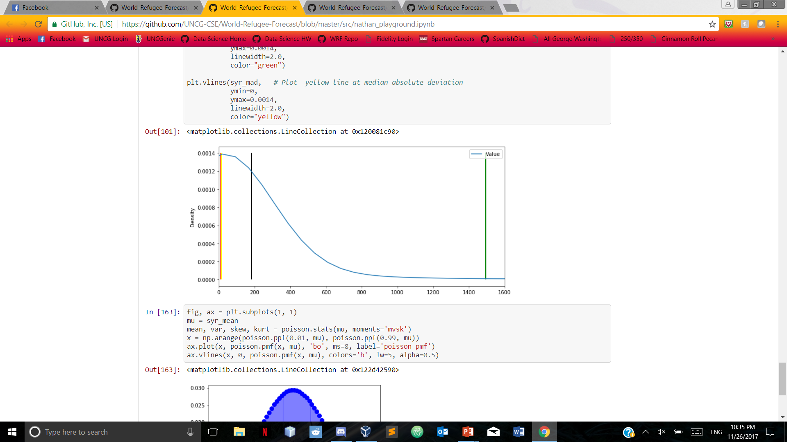
Divergence of mean Somalia syria
Black line indicates mean, red line indicates median, green line indicates standard deviation, yellow line indicates median absolute deviation

Slide 8
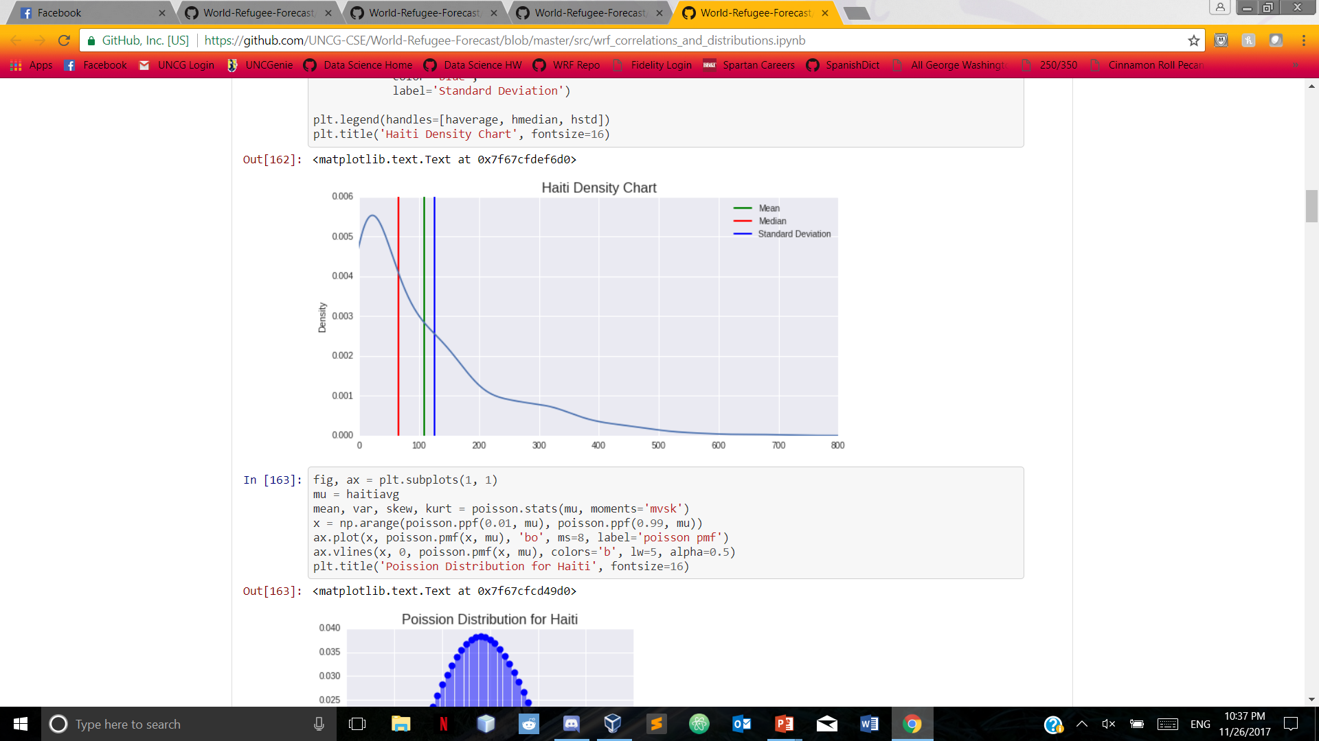
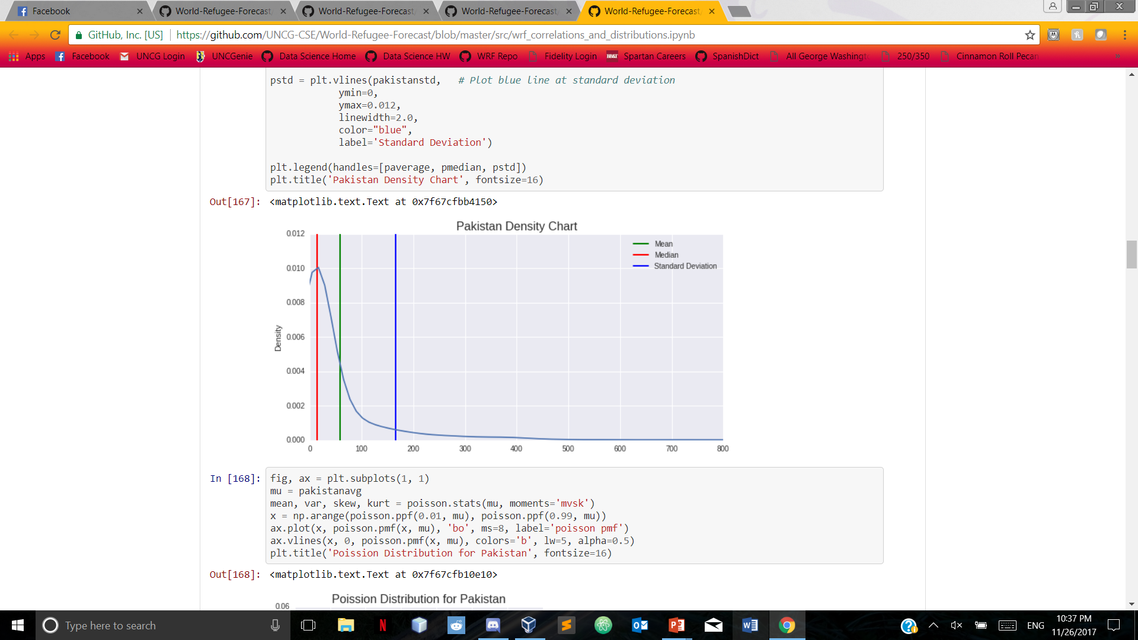


Slide 9
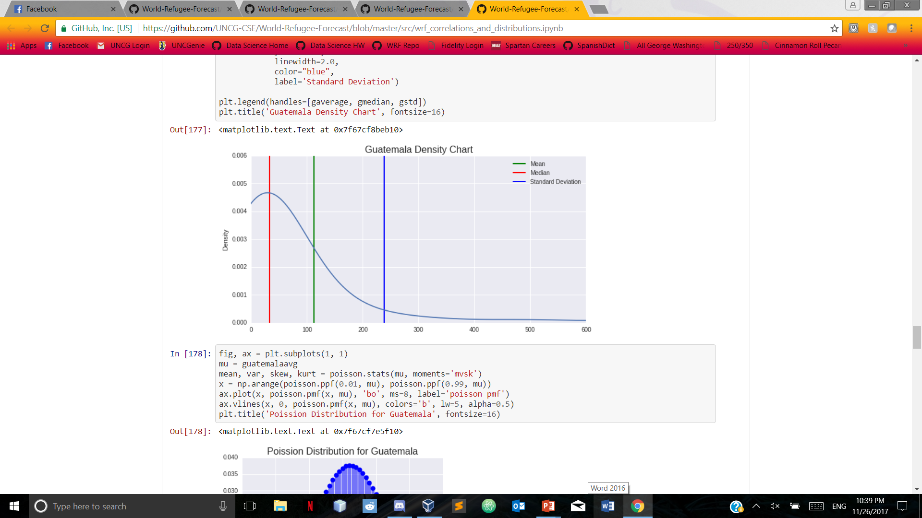
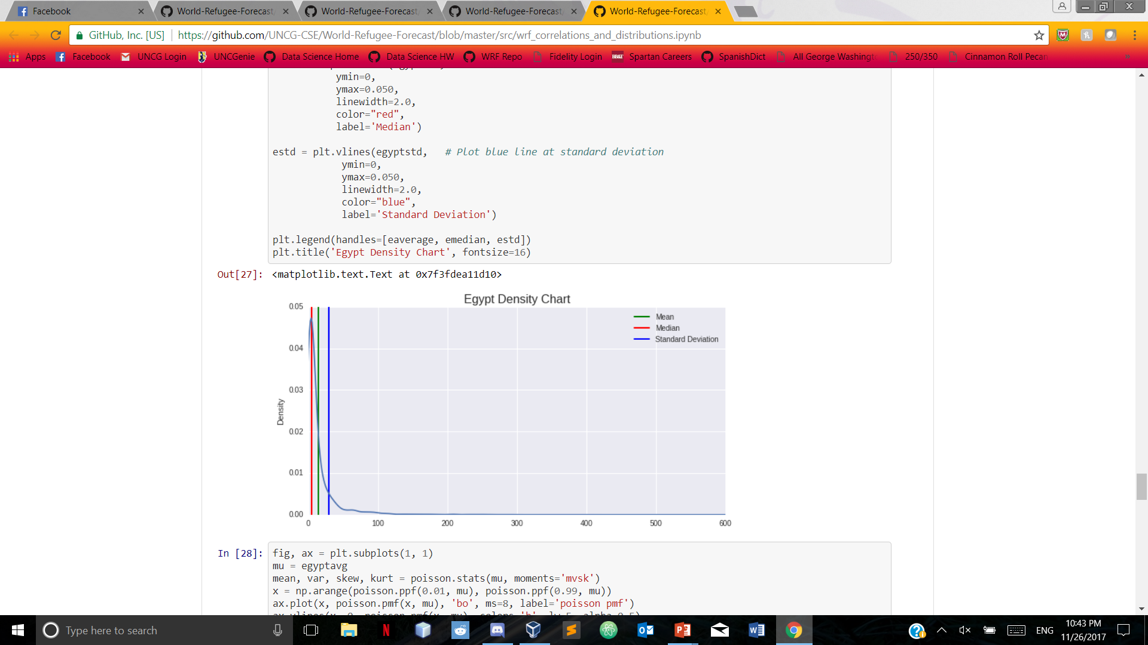

Slide 10
Statistical DIstribution
Since we want to determine the probability of a refugee choosing a particular country for asylum, we chose a Poisson distribution
Applied to the same countries that were used for divergence of mean

Slide 11
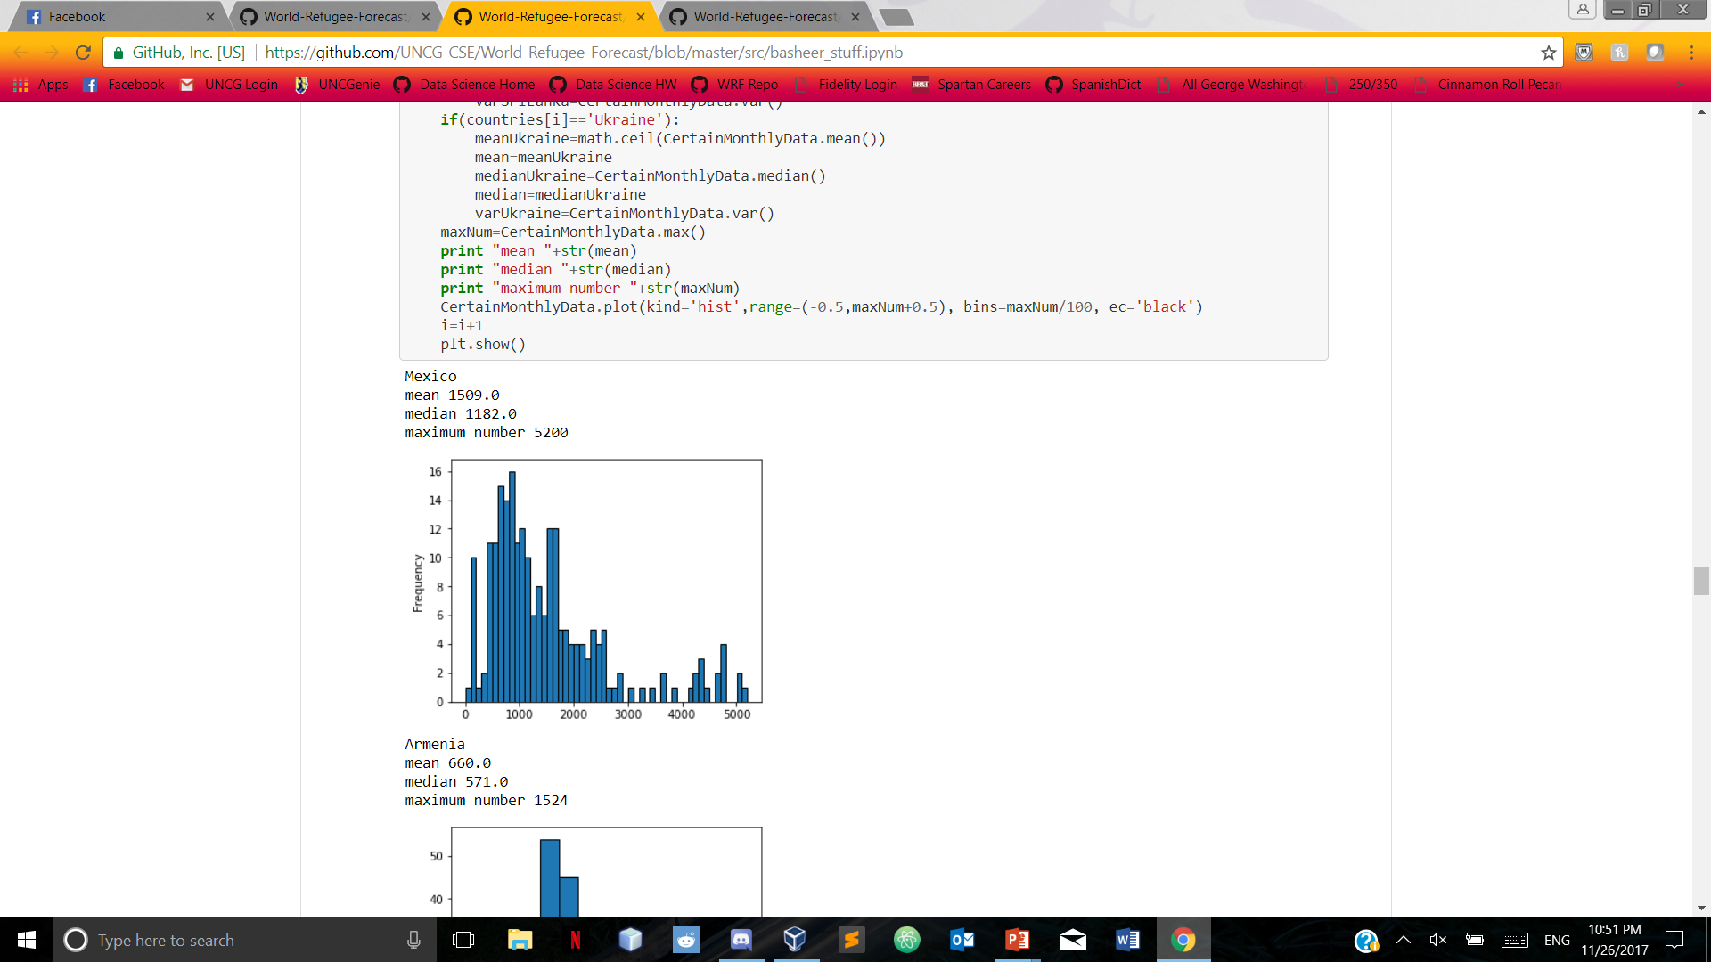
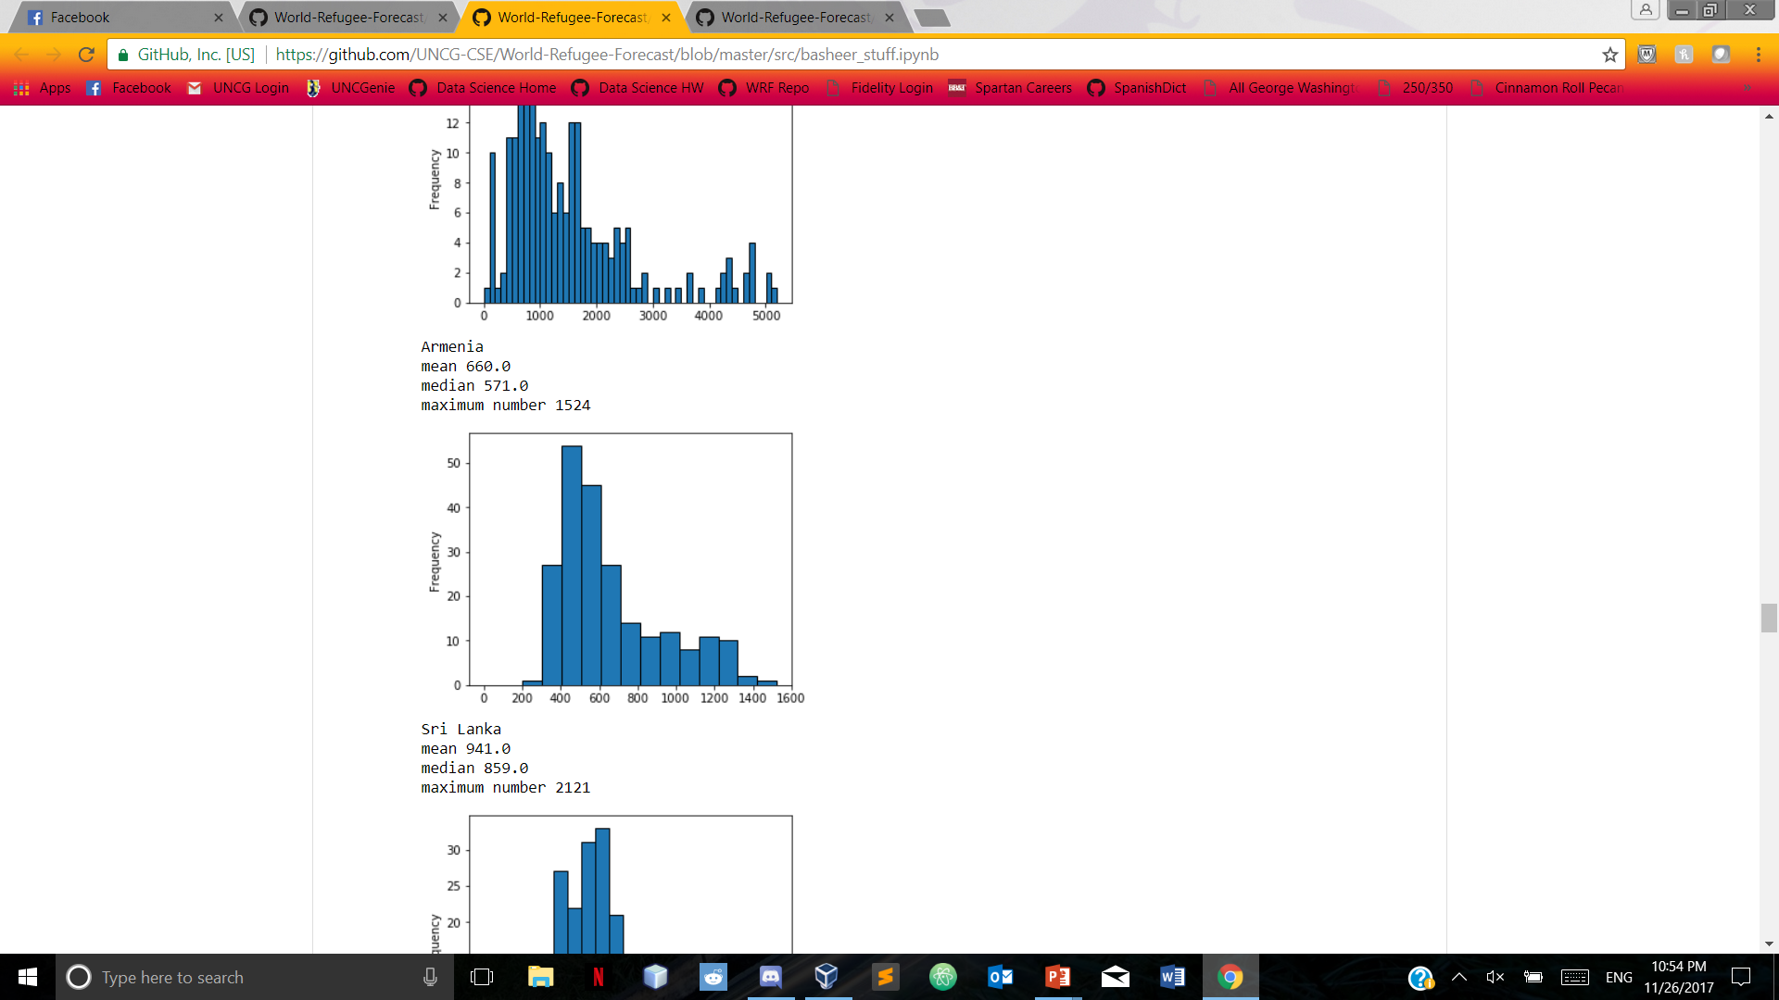
Poisson Distribution: Mexico and Armenia

Slide 12
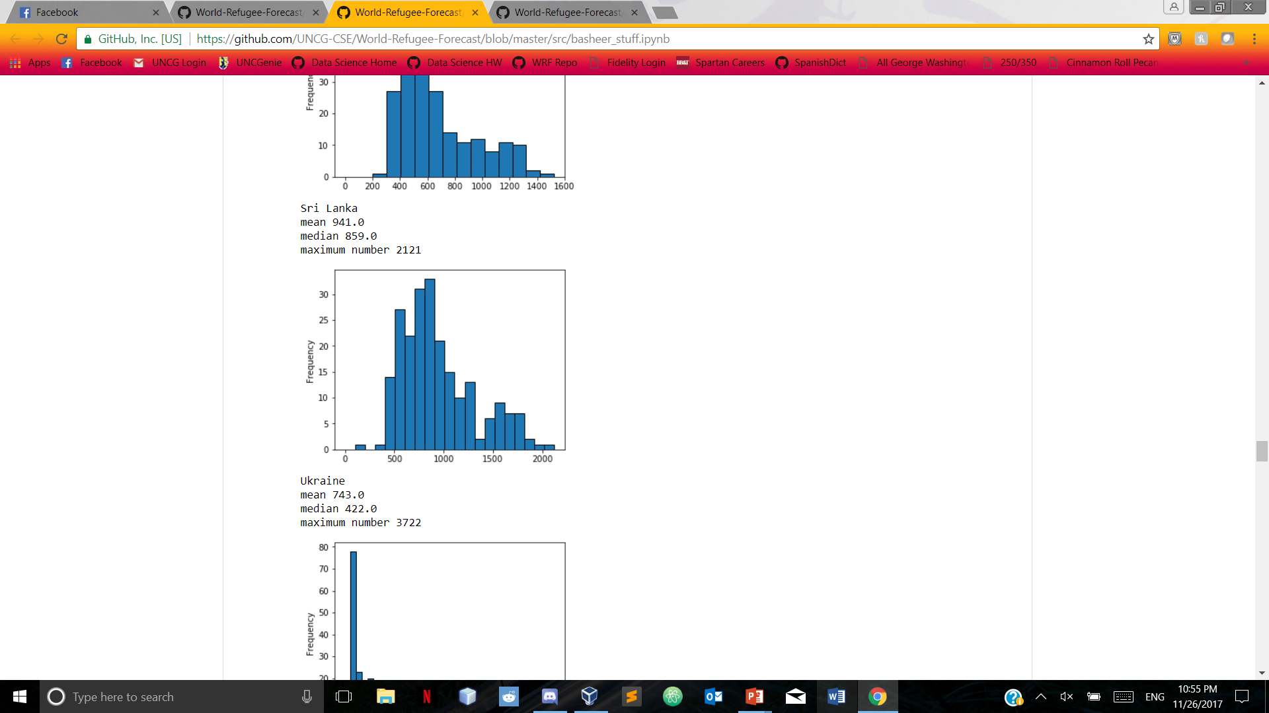
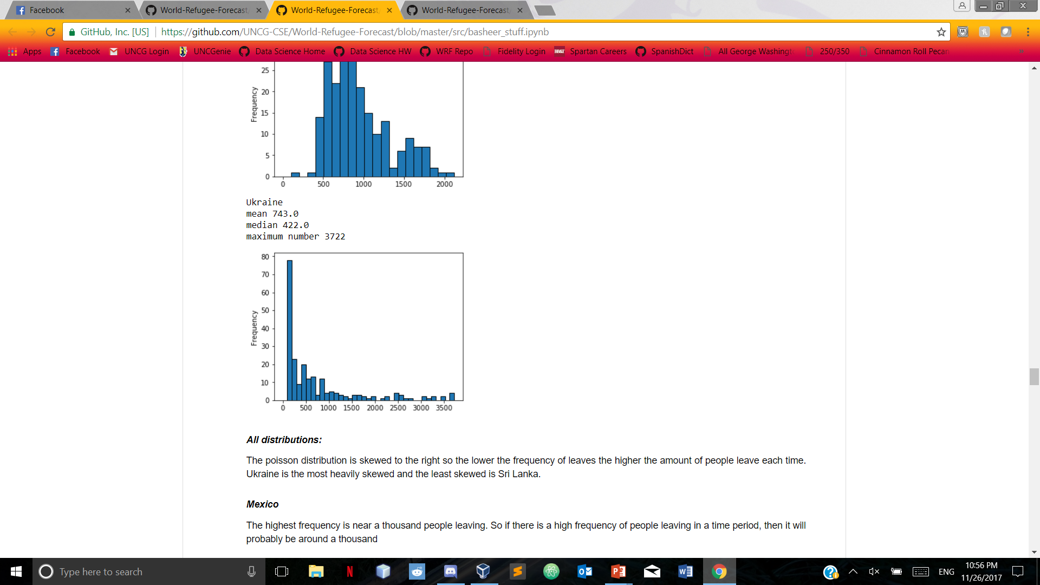
Poisson Distribution: Sri Lanka and Ukraine

Slide 13
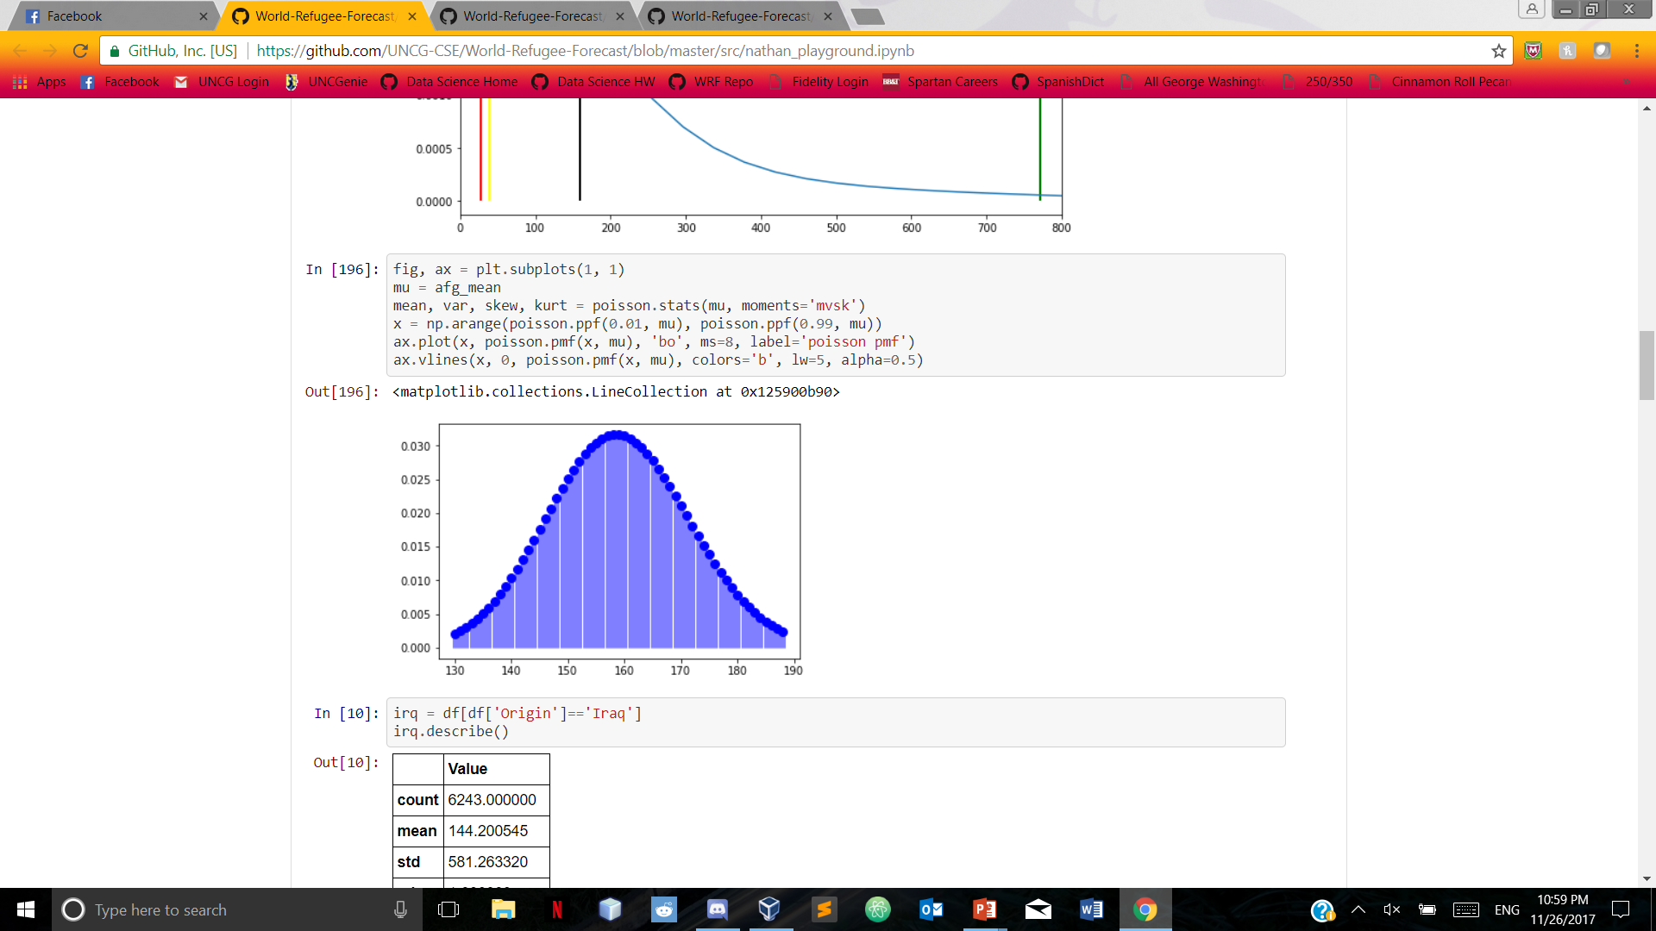
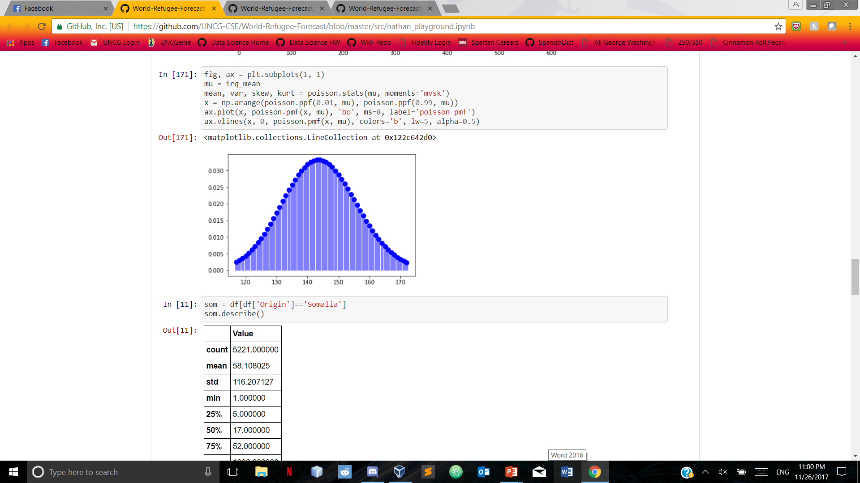
Poisson distribution: Afghanistan and Iraq

Slide 14
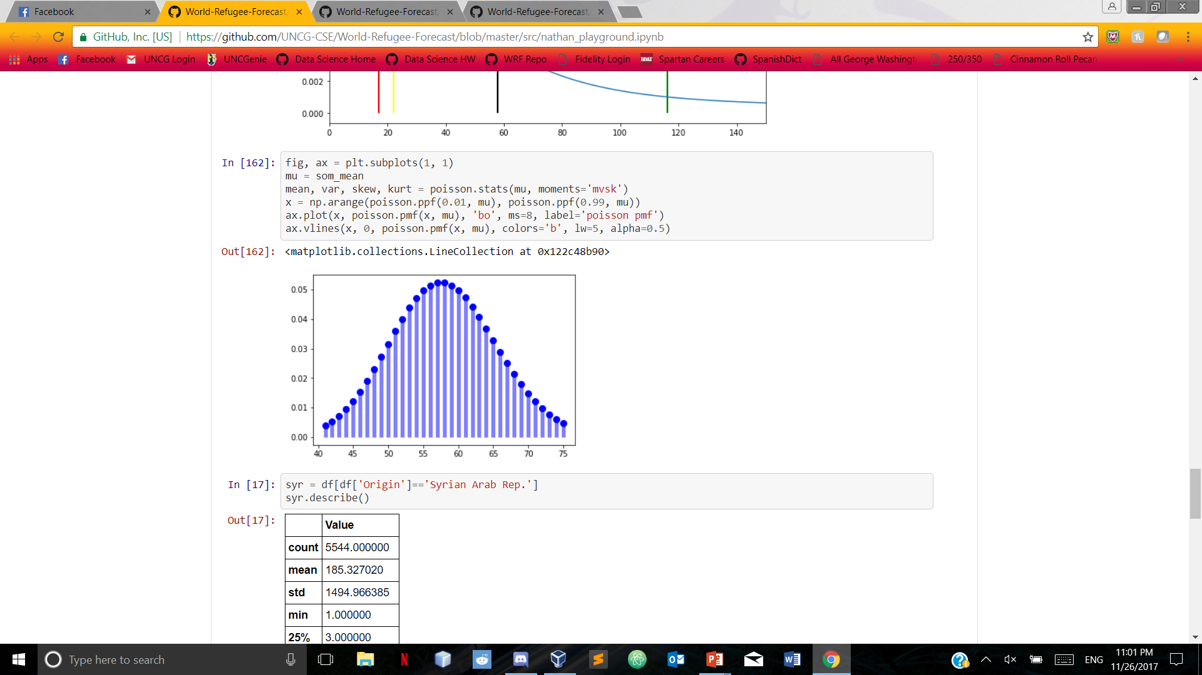
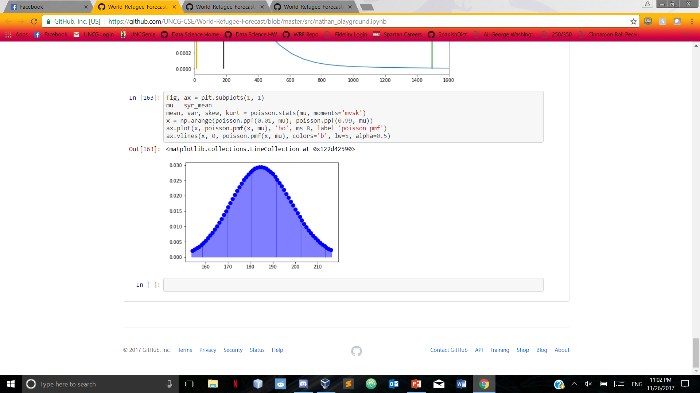
Poisson distribution: Somalia and Syria

Slide 15
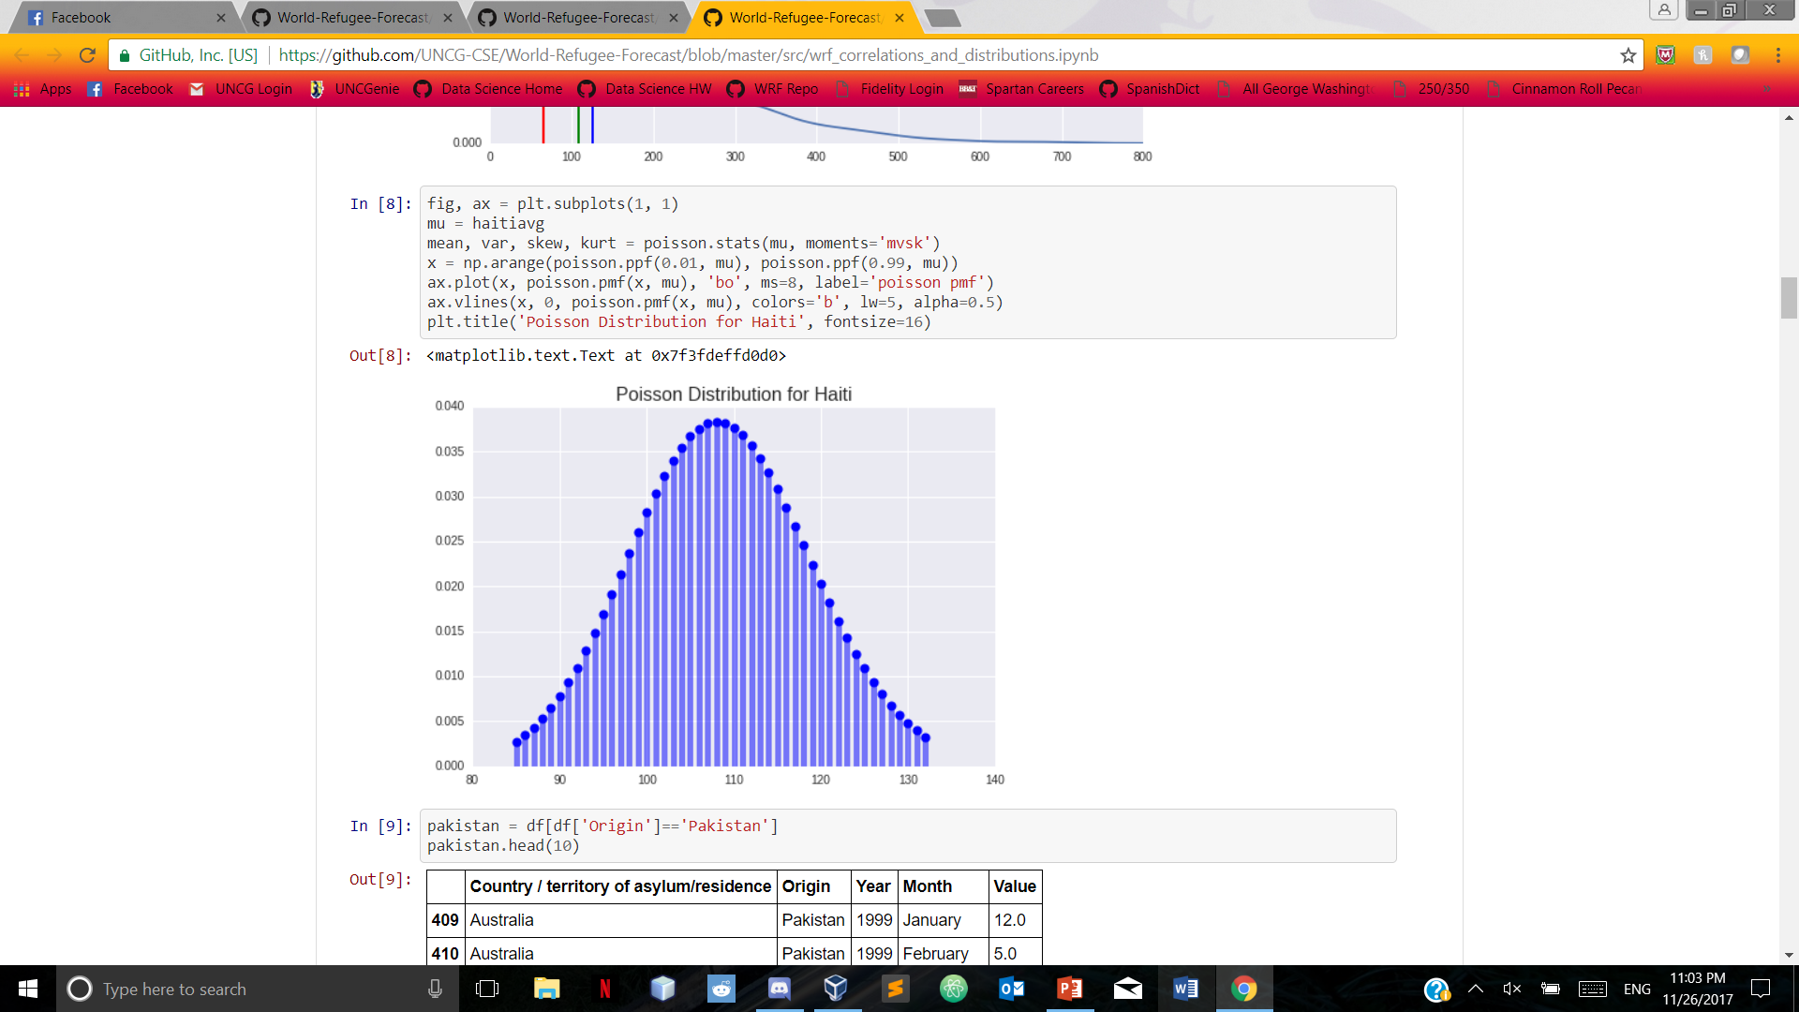
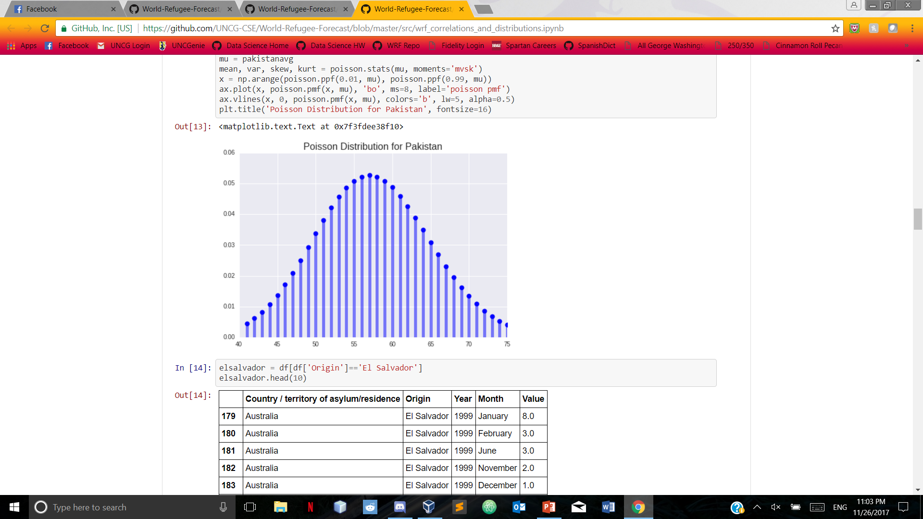
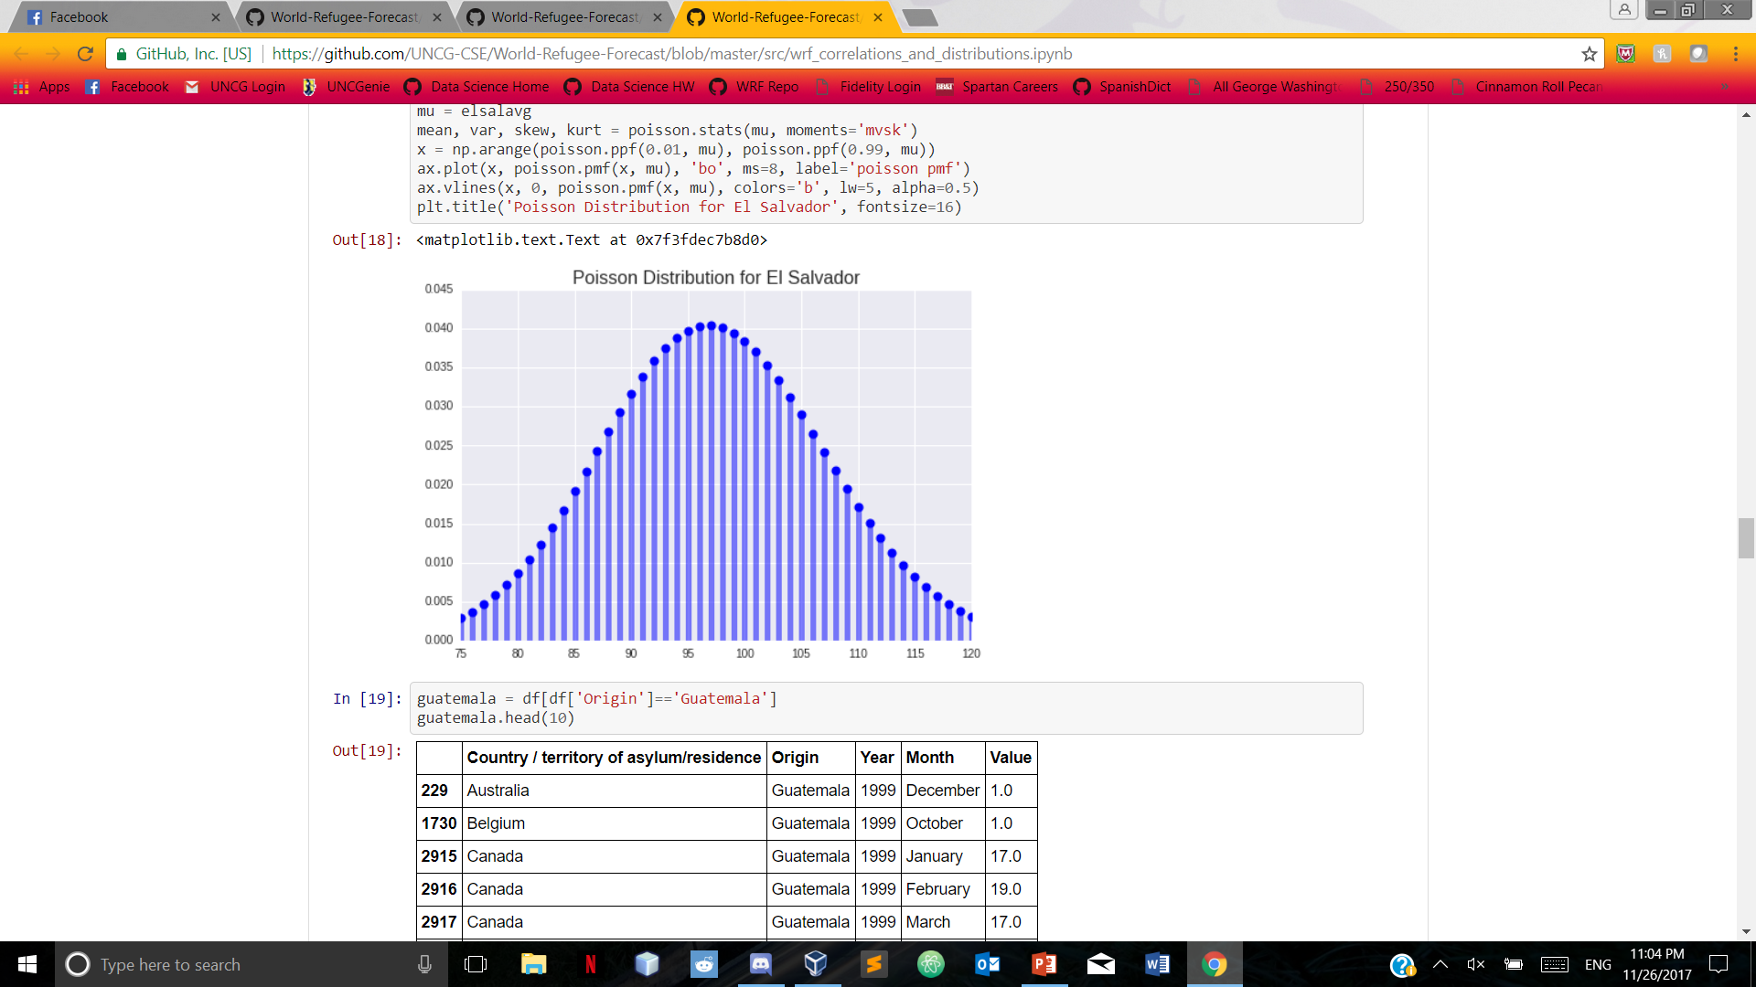

Slide 16
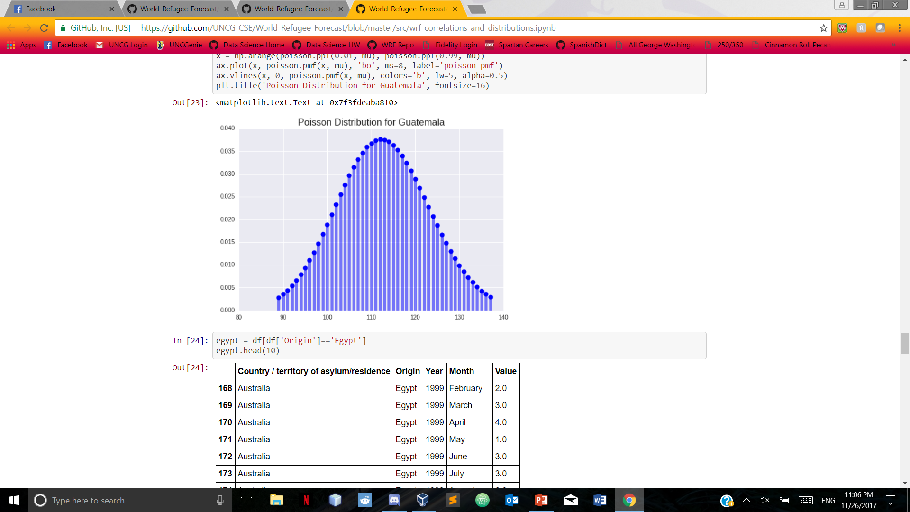
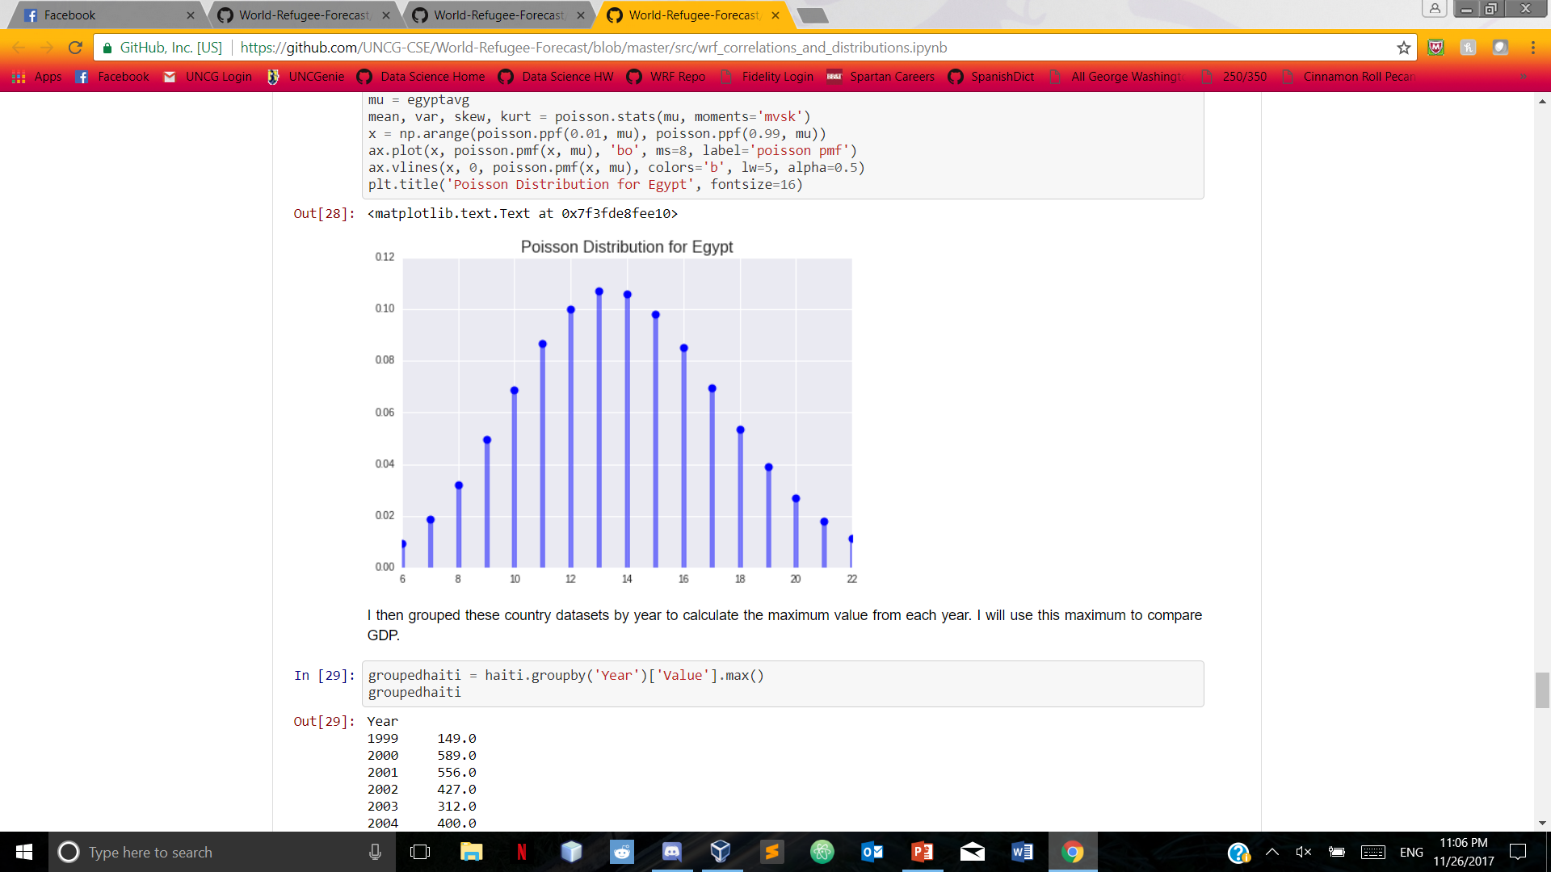

Slide 17
Linear regression
We picked a few countries to analyze using linear regression
Analyzed them alongside the food deficit data to determine if there was any relation to the food deficit and the number of people fleeing the country

Slide 18
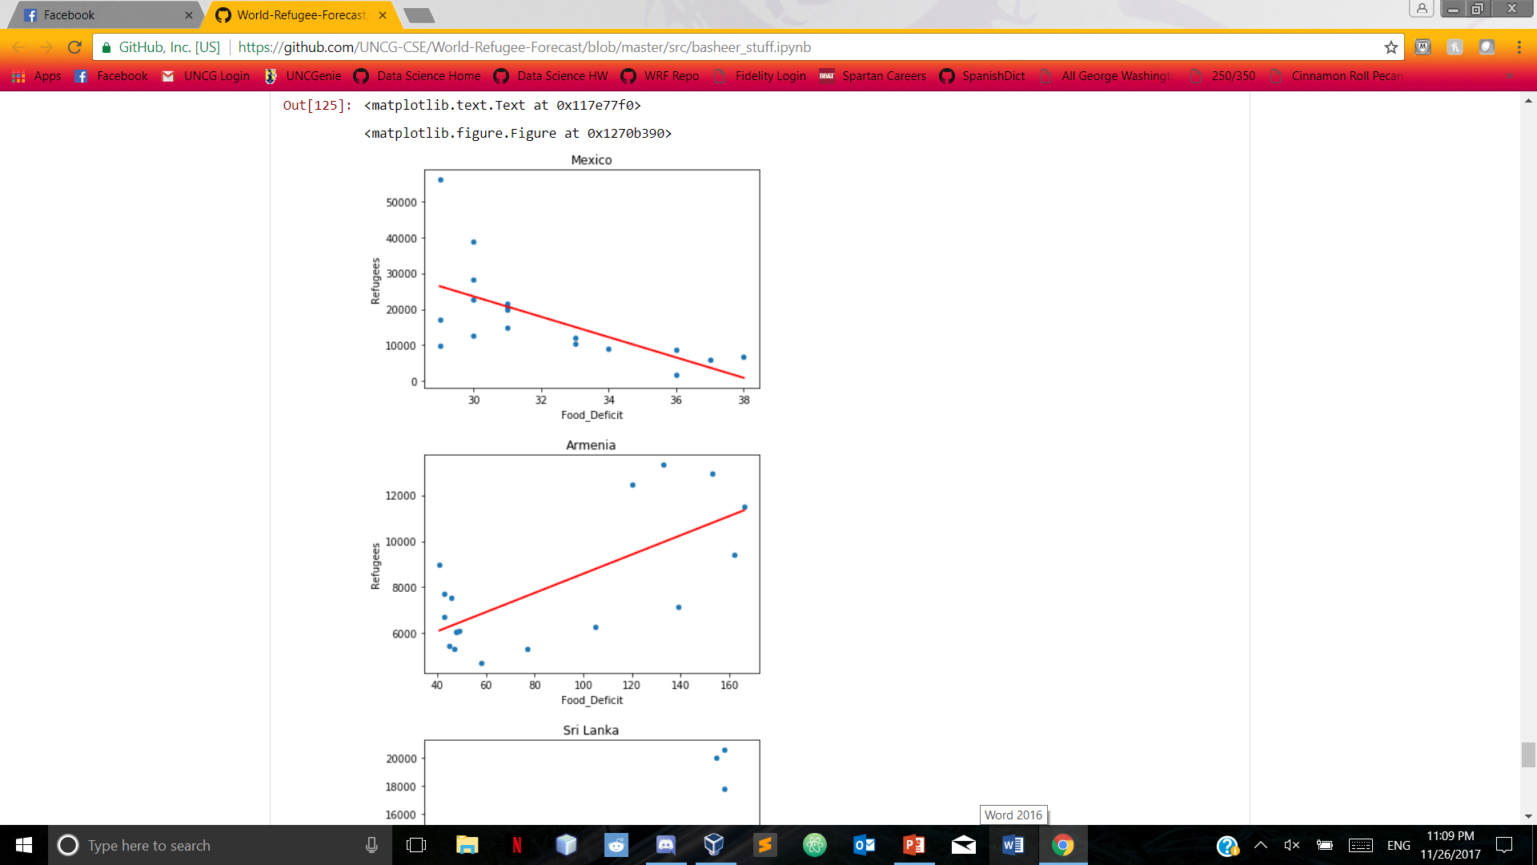
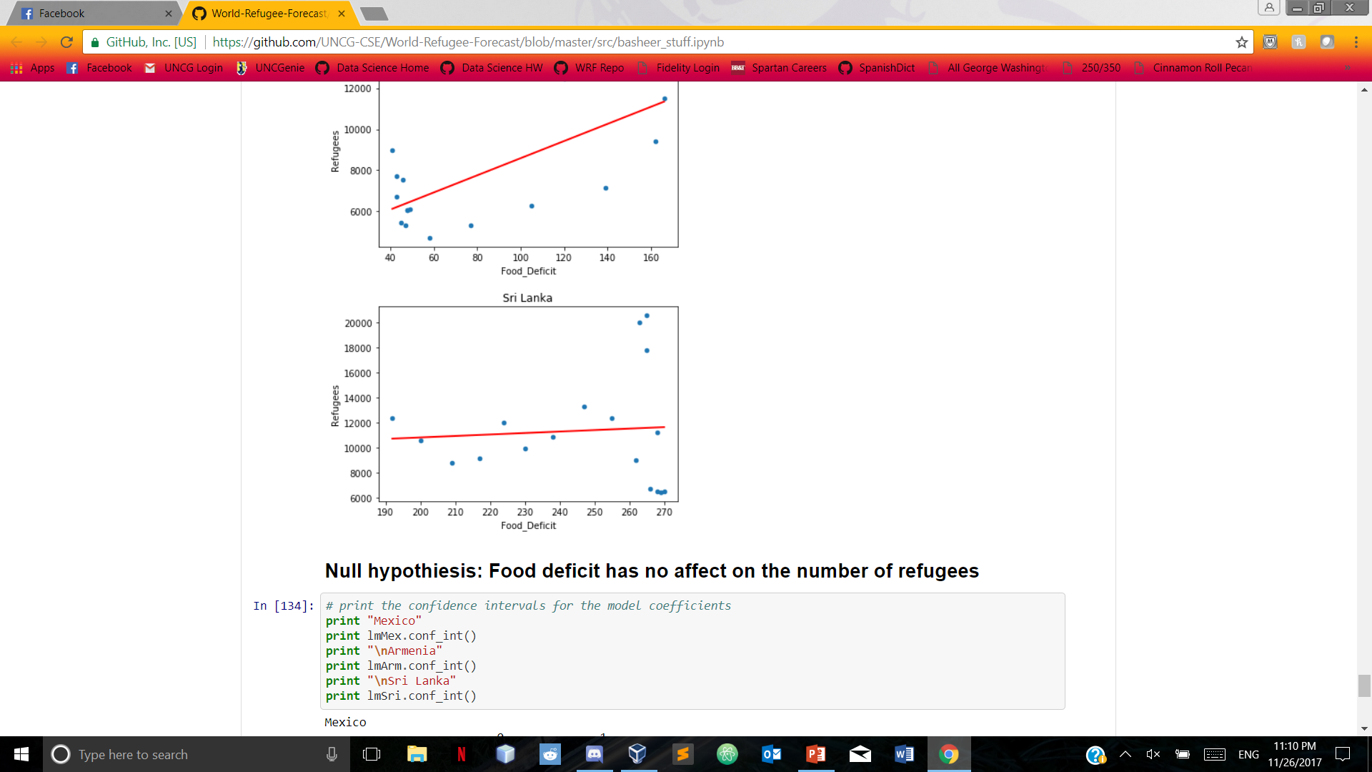
Linear regression: Mexico, Armenia, sri lanka

